Slide 1
CC-1
UNIT 2 : DIVERSITY IN MICROBIAL WORLD
Taken by : Mrs.Shinjini Dhar Halder
Faculty ;Microbiology Department ,Hooghly Womens College

Slide 2
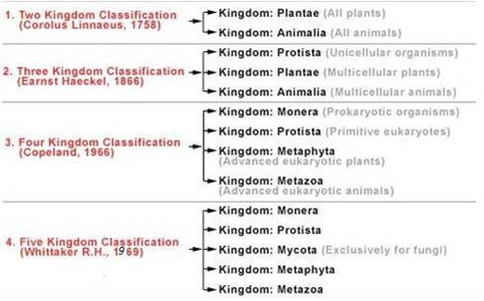
DIFFERENT CLASSIFICATION SYSTEMS

Slide 3
SYSTEMS OF CLASSIFICATION : IDEA ABOUT HACKEL AND WHITTAKER’S KINDGOM CONCEPT
1860s, the German investigator Ernst Haeckel proposed a three-kingdom system of classification.
Haeckel’s three kingdoms were Animalia, Plantae, and Protista.
Members of the kingdom Protista included the protozoa, fungi, bacteria, and other microorganisms.
Haeckel’s system was not widely accepted, however, and microorganisms continued to be classified as plants (for example, bacteria and fungi) or animals (for example, protozoa).

Slide 4
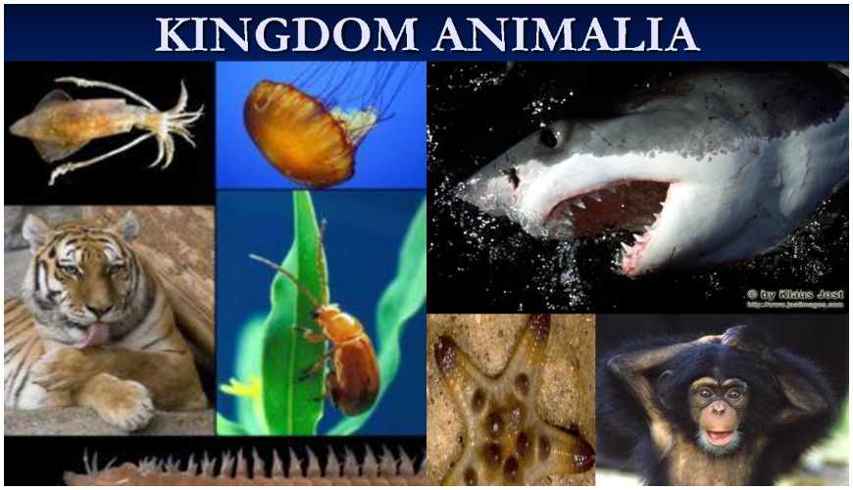
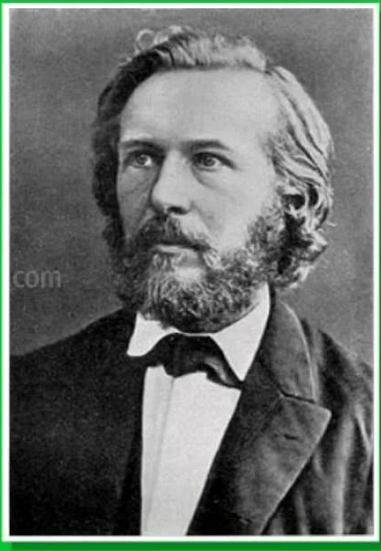
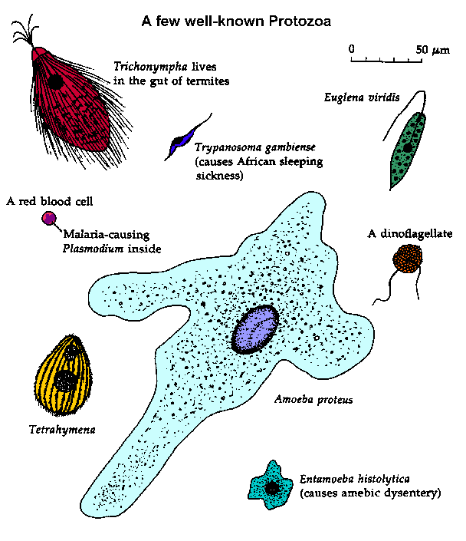

HACKEL AND THREE KINGOM CLASSIFICATION
KINGDOM PLANTAE
HACKEL
KINGDOM PROTIASTA

Slide 5
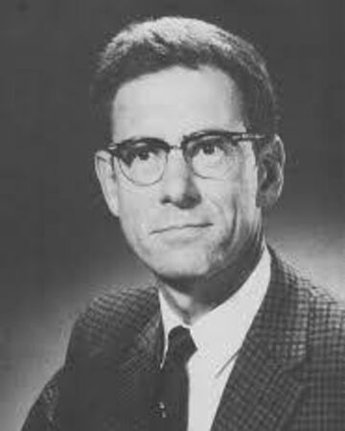
In 1968, Robert Whittaker devised a system that was widely accepted by biologists for many years.
Whittaker’s classification scheme recognized five kingdoms: Monera, Protista, Fungi, Plantae, and Animalia.
Robert Whittaker

Slide 6
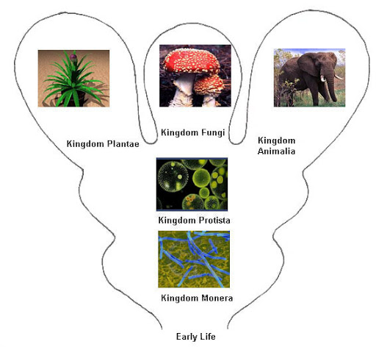
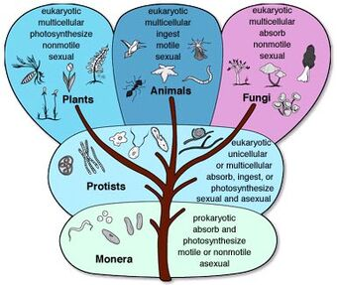
WHITTEKER’S FIVE KINGDOM CLASSIFICATION

Slide 7
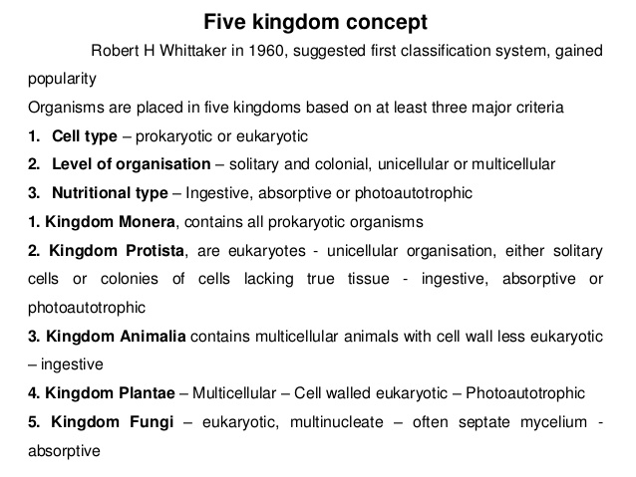

Slide 8
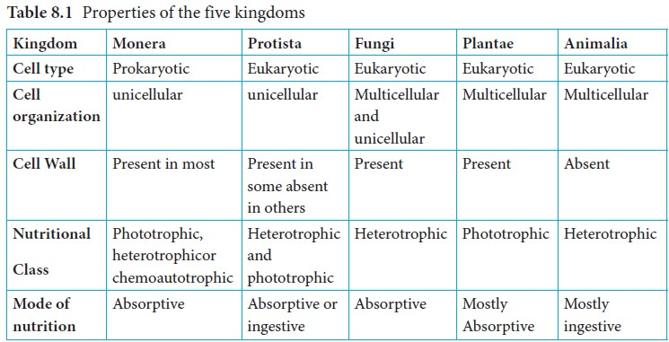
PROPERTIES OF FIVE KINGDOM CLASSIFICAION

Slide 9
ADVANTAGES AND DISADVANTTAGES OF FIVE KINGDOM CLASSIFICATION
Advantages
Prokaryotes differ from all other living organisms in their cellular structure.
Unicellular and multicellular organisms are kept separately.
Fungi are placed in a separate kingdom as their mode of nutrition differs.
Better than two kingdom classification.
Disadvantages
Unicellular algae are kept in kingdom Protista, whereas algae like multicellular organisms are kept in kingdom Plantae. But similar organisms must be put together.
There is diversity in kingdom Protista. Dissimilar organisms must not be kept in the same group.
There is no place for viruses.
Similar organisms are kept far from each other. For example- Unicellular and multicellular algae.

Slide 10

THREE DOMAIN CLASSIFICATION
After 1990, The Domain kingdom classification system or Carl Woese’s Classification or Six Kingdoms and Three Domains Classification was introduced.
This classification system is based on the genetic characteristics (rather than phenotypic ones) with respect to evolutionary relatedness (phylogeny) of organisms that may prove more stable and predictable.

Slide 11
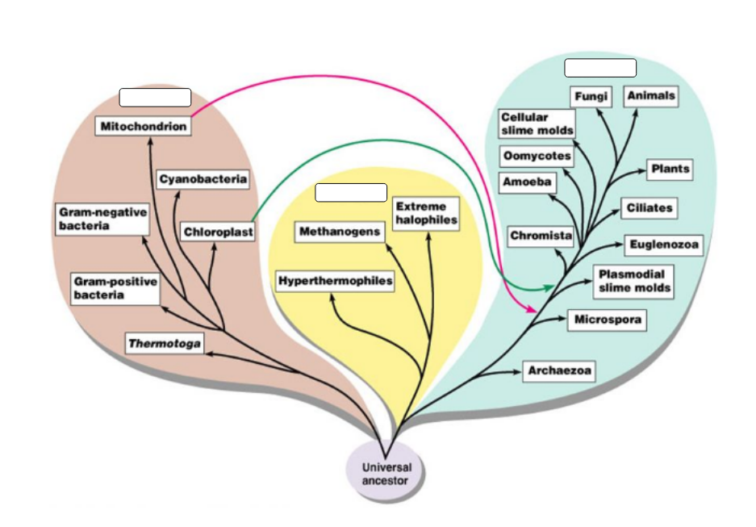
THREE DOMAIN CLASSIFICATION

Slide 12
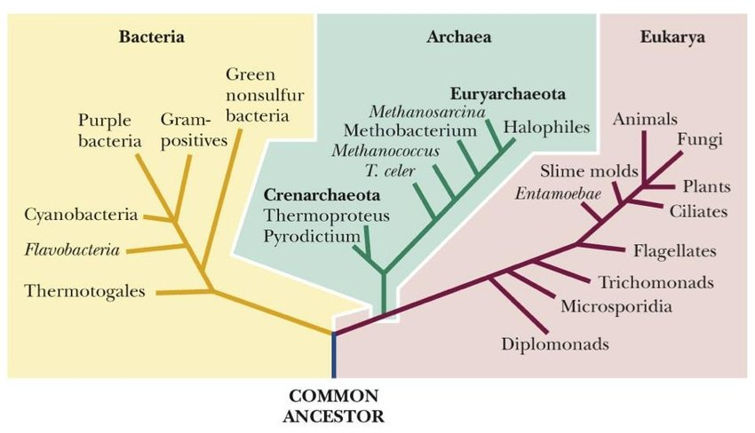
THREE DOMAIN CLASSIFICATION

Slide 13
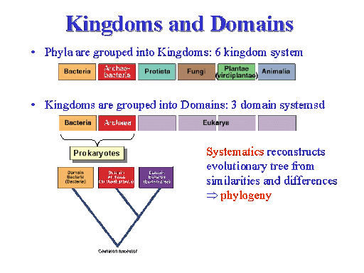
RELATIONSHIP BETWEEN KINGDOM AND DOMAIN

Slide 14
Advantages of the Three domain system:
- based on evolutionary relationships, which also show how kingdoms are related
- determines relationships with DNA sequencing and phylogenetics
- broadly classifies biodiversity into Eubacteria, Archaeabacteria and Eukarya allowing for kingdom changes

Slide 15
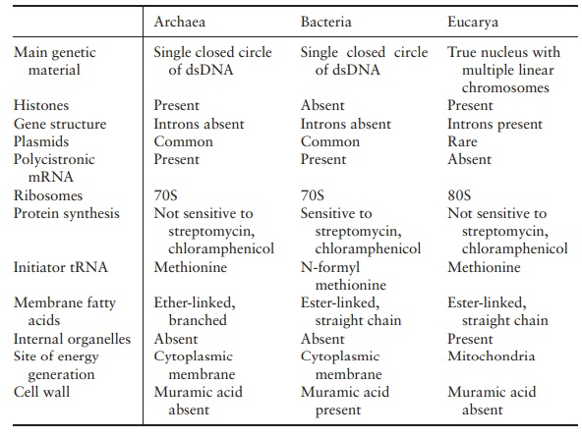
Three domain of life

Slide 16
GENERAL CHARACTERS OF DIFFERENT GROUPS
ARCHAE :
Archaebacteria may be Gram-positive or Gram-negative. Cells are generally invested with a cell- wall, (except Thermo plasma).
Archaebacterial cells may be spherical, rod-shaped, spiral, irregularly lobed as in Sulfolobus, or filamentous.
Cell diameter ranges between 0.1 μm and 1.5 μm. Cells multiply by several means, like binary fission, budding, fragmentation etc.
The organisms may be aerobic, anaerobic, chemolithotrophic or chemoorganotrophic.
They mostly occur in extreme environments, though some are mesophilic. Gram- positive archaebacteria have a thick homogeneous cell wall mainly containing complex polysaccharide. The Gram-negative forms have a thinner wall consisting mainly of protein or glycoprotein.

Slide 17
GENERAL CHARACTERS OF DIFFERENT GROUPS
ARCHAE :
An outer membrane characteristically present in the Gram-negative true bacteria is absent in archaebacteria. Murein is absent in the cell wall of both Gram-positive and Gram-negative archaebacteria.
Due to the absence of murein, the archaebacteria are insensitive to β-lactam antibiotics like penicillins, cephalosporin’s, etc.
A unique feature of archaebacteria is the presence of ether-linked isopranyl lipids in their membranes.
archaebacteria have a covalently linked closed circular genome, but its size is generally smaller than that of other prokaryotes.

Slide 18
